Slide 1

Earthquake VISUALISATION
Xiaoxuan Xiang

Slide 2

About Data Set
Data source
The data set contains details of all earthquakes that have happened in the last 30 days and is updated every 15 mins in the USGS website.​
URL:
Earthquakhttps://www.kaggle.com/datasets/farazrahman/earthquake?taskId=6195e | Kaggle

Slide 3

Aim of the VISUALISATION
Explore the basic distribution of earthquakes
2. Explore the distribution of earthquakes across different Temperature Zone

Slide 4
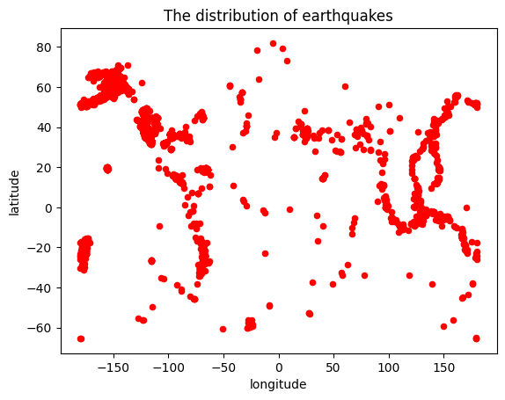
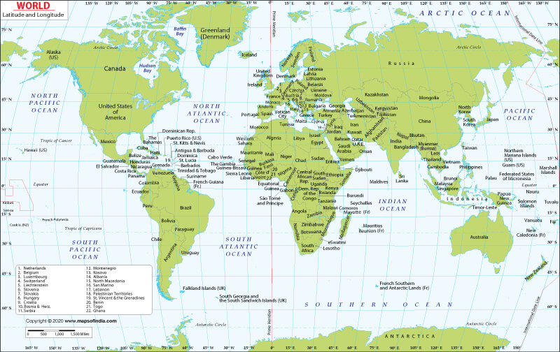
The distribution of Earthquakes on the earth
World map

Slide 5
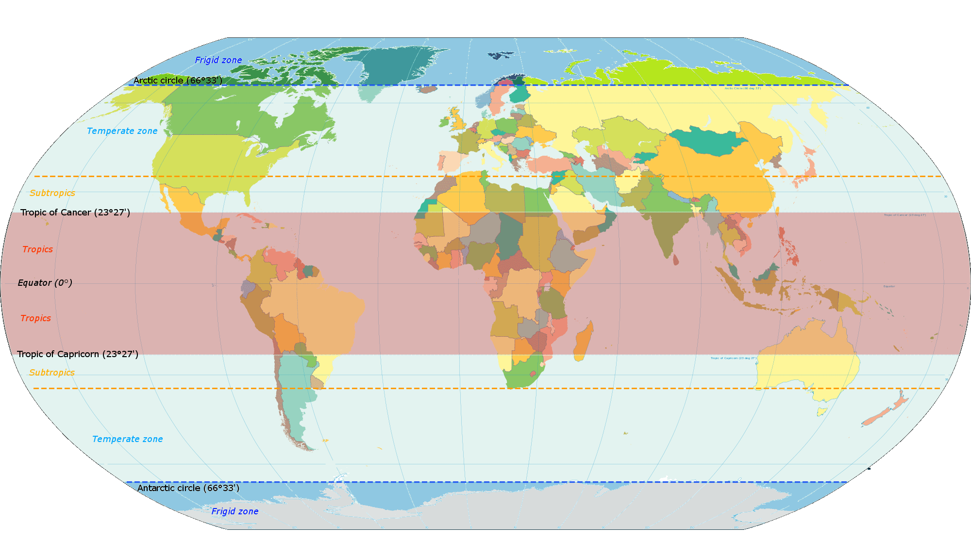
The distribution of EARTHQUAKES Across TEmPERATURE zone
Tropic Zone:23.27°S-23.27°N
Northern Temperate Zone:23.27°N-66.33°N
Southern Temperate Zone:23.27°S-66.33°S
Northern Frigid Zone:66.33°N+
Southern Frigid Zone 66.33°S+

Slide 6
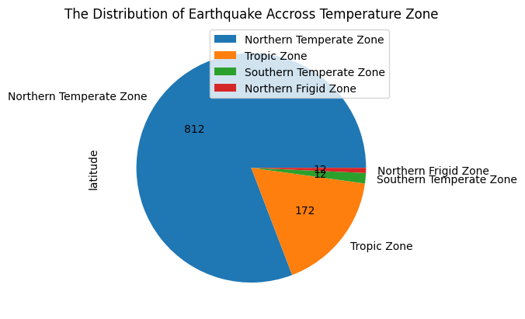
The distribution of Earthquakes Across TEmPERATURE zone
Conclusion:
1.
Most of earthquakes happen in the Northern Temperature Zone.
2.None of earthquakes happen in the Southern Frigid Zone, and only small proportion of earthquakes happen in Southern Temperate Zone.
3.
Northern hemisphere suffers from more earthquakes than Southern hemisphere

